Slide 1
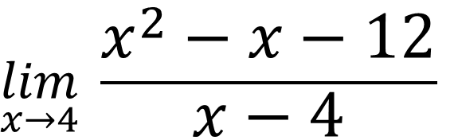
Bell Work
Evaluate the following limit.
$$\lim_{x→4}{ \frac{x^{2}−x−12}{x−4}}$$

Slide 2
From Last Time…
Page 858 #5, 7, 9, 13, 29, 30, 31, 33, 49, 53, 61

Slide 3
Pre-calc trig
Day 19

Slide 4
12.2 Techniques for Evaluating Limits
Objective: Evaluate one-sided limits
12.3 The Tangent Line Problem
Objective: Find Derivatives of functions and find slopes of graphs.

Slide 5
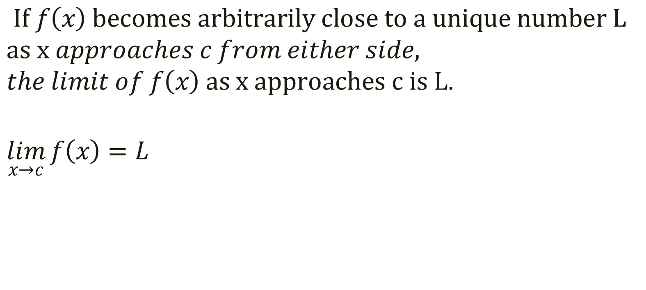
Remember… Definition of Limit
$If f\left(x\right) becomes arbitrarily close to a unique number L$
$$as x approaches c from either side,$$
$$the limit of f\left(x\right) as x approaches c is L.$$
$$\lim_{x→c}{f\left(x\right)=L}$$

Slide 6
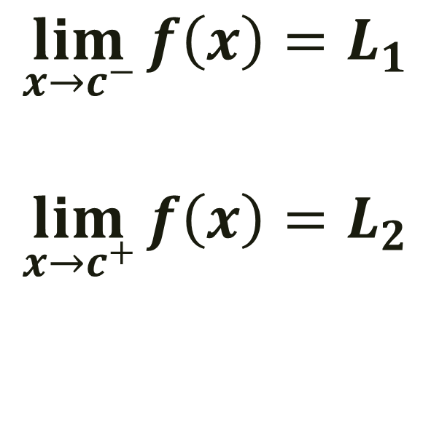
12.2 Techniques for Evaluating Limits
$$\lim_{x→c^{−}}{f\left(x\right)=L_{1}}$$
$$\lim_{x→c^{+}}{f\left(x\right)=L_{2}}$$

Slide 7
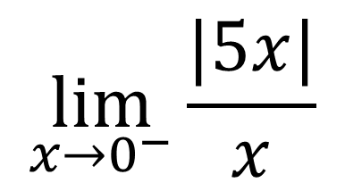
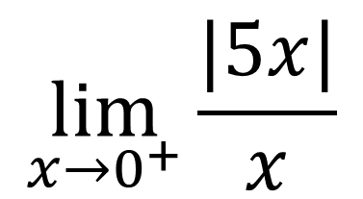
Example 1:
$$\lim_{x→0^{+}}{\frac{|5x|}{x}}$$
$$\lim_{x→0^{−}}{\frac{|5x|}{x}}$$
x | 3 2 1 0.5 0.25
f(x) |
x | -3 -2 -1 -0.5 -0.25
f(x) |

Slide 8

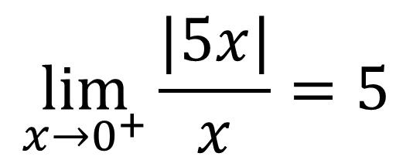
Example 1:
$$\lim_{x→0^{+}}{\frac{|5x|}{x}}$$
$$\lim_{x→0^{−}}{\frac{|5x|}{x}}$$
x | 3 2 1 0.5 0.25
f(x) | 5 5 5 5 5
x | -3 -2 -1 -0.5 -0.25
f(x) | -5 -5 -5 -5 -5
$$\lim_{x→0^{+}}{\frac{|5x|}{x}=5}$$
$$\lim_{x→0^{+}}{\frac{|5x|}{x}=−5}$$

Slide 9
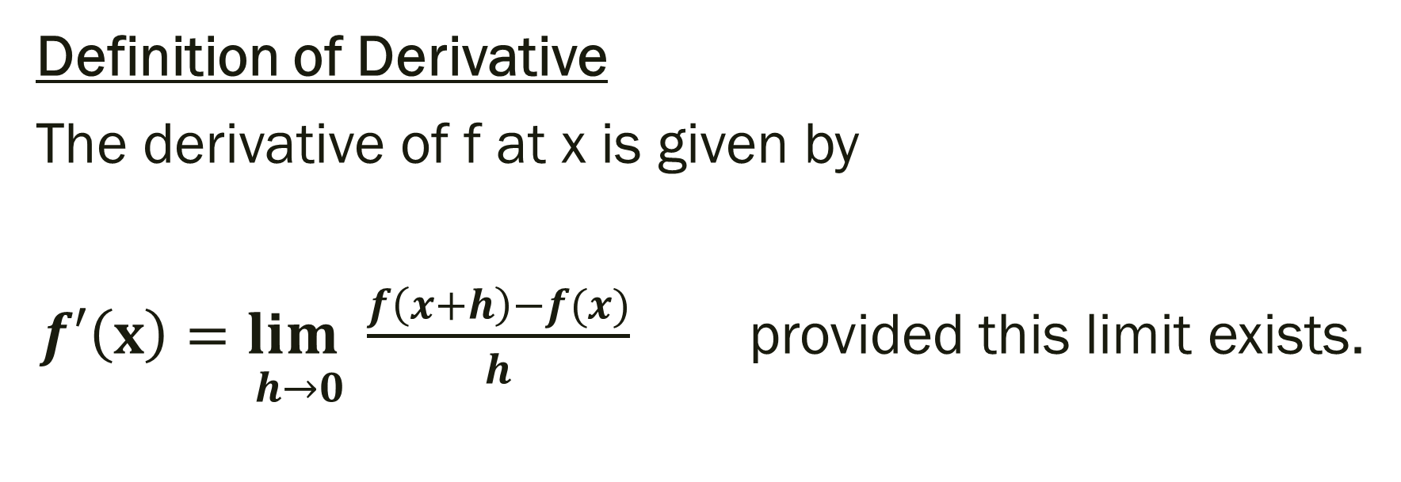
12.3 The Tangent Line Problem
Definition of Derivative
The derivative of f at x is given by
$\underset{ h→0}{f′\left(x\right)=lim}{\frac{f\left(x+h\right)−f(x)}{h}}$ provided this limit exists.

Slide 10
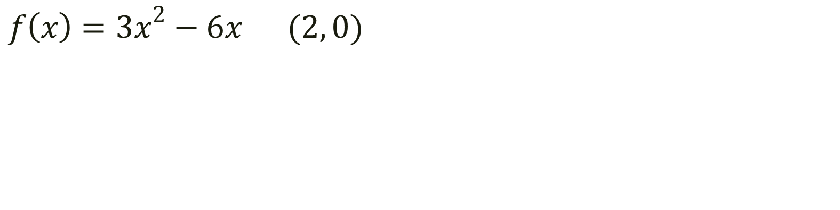
Example: Find the derivative and use it to identify the slope of the tangent through the given point.
$$f\left(x\right)={3x}^{2}−6x (2, 0)$$

Slide 11
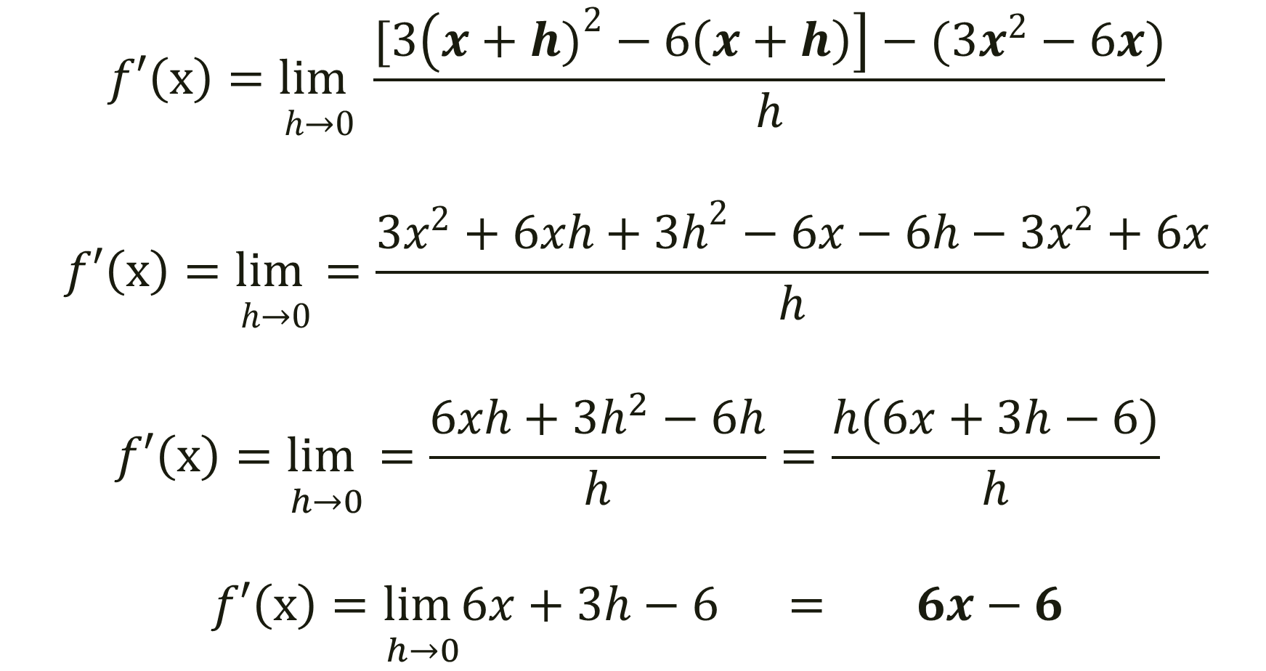
$$f\left(x\right)={3x}^{2}−6x (2, 0)$$
$$\underset{ h→0}{f′\left(x\right)=lim}{\frac{[3\left(x+h)^{2}−6\left(x+h\right)\right]−(3x^{2}−6x)}{h}}$$
$$\underset{ h→0}{f′\left(x\right)=lim}=\frac{3x^{2}+6xh+3h^{2}−6x−6h−3x^{2}+6x}{h}$$
$$\underset{ h→0}{f′\left(x\right)=lim}=\frac{6xh+3h^{2}−6h}{h}=\frac{h(6x+3h−6)}{h}$$
$$\underset{ h→0}{f′\left(x\right)=lim}6x+3h−6 = 6x−6$$

Slide 12
Solution
Since the derivative is 6x-6…
Therefore the slope of the tangent through (2,0) is at f’(2)=6(2) – 6 …
f’(2) = 6
Graph to see.

Slide 13
For next time…
Page 868 #5, 7, 9, 11, 49
Page 878 #5, 6, 9, 10

